Slide 1



Why bother with MEG?
when we can buy more MRIs?
.. or .. about that time we had the brilliant idea of recording simultaneous MEEG

Slide 2
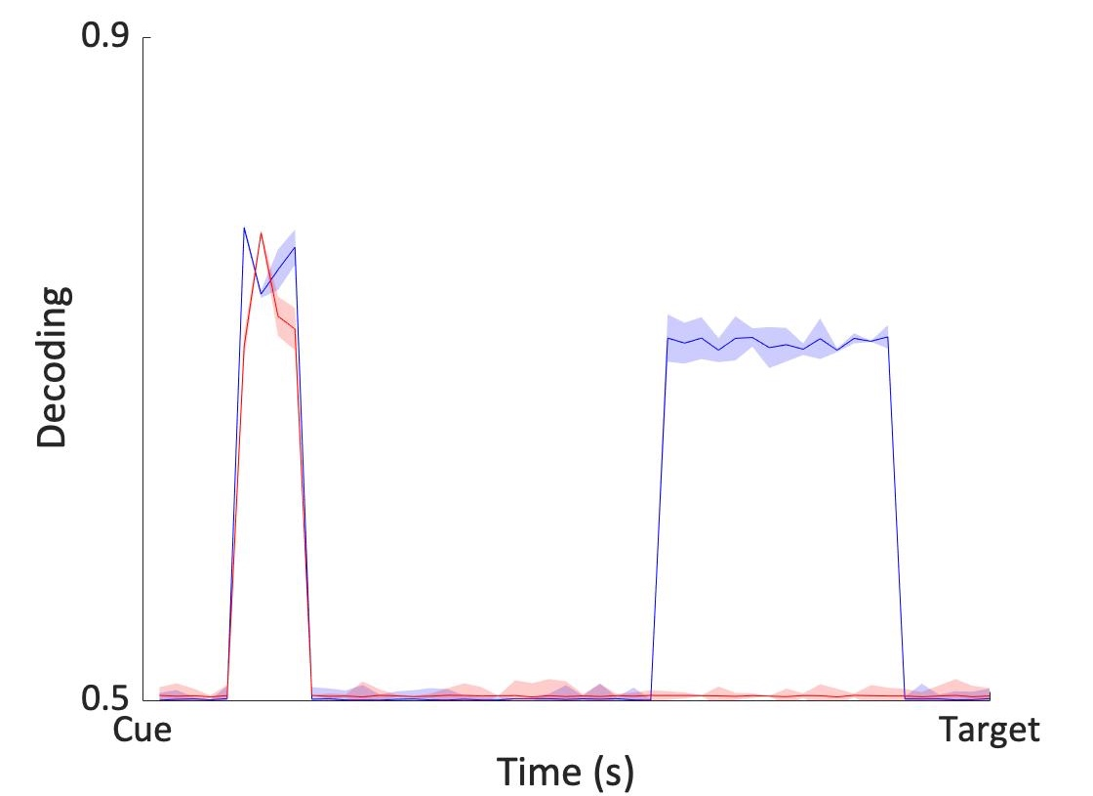

EEG doesn’t pick up on auditory alpha
In a task of spatial auditory attention
Decoding MEG > EEG
EEG
MEG
Auditory alpha
Figure.
Me having an idea

Slide 3


Paradigm
VISUAL CUE
200 ms
TARGET
100 ms
Informative
DELAY
1000 ms
Uninformative
or
n = 14
100% Valid
Discrimination
Task

Slide 4
Method
Incorrect trials excluded
Cue-locked
ICA + artefact rejection
Same trials for both ‘modalities’
compare decoding performance

Slide 5
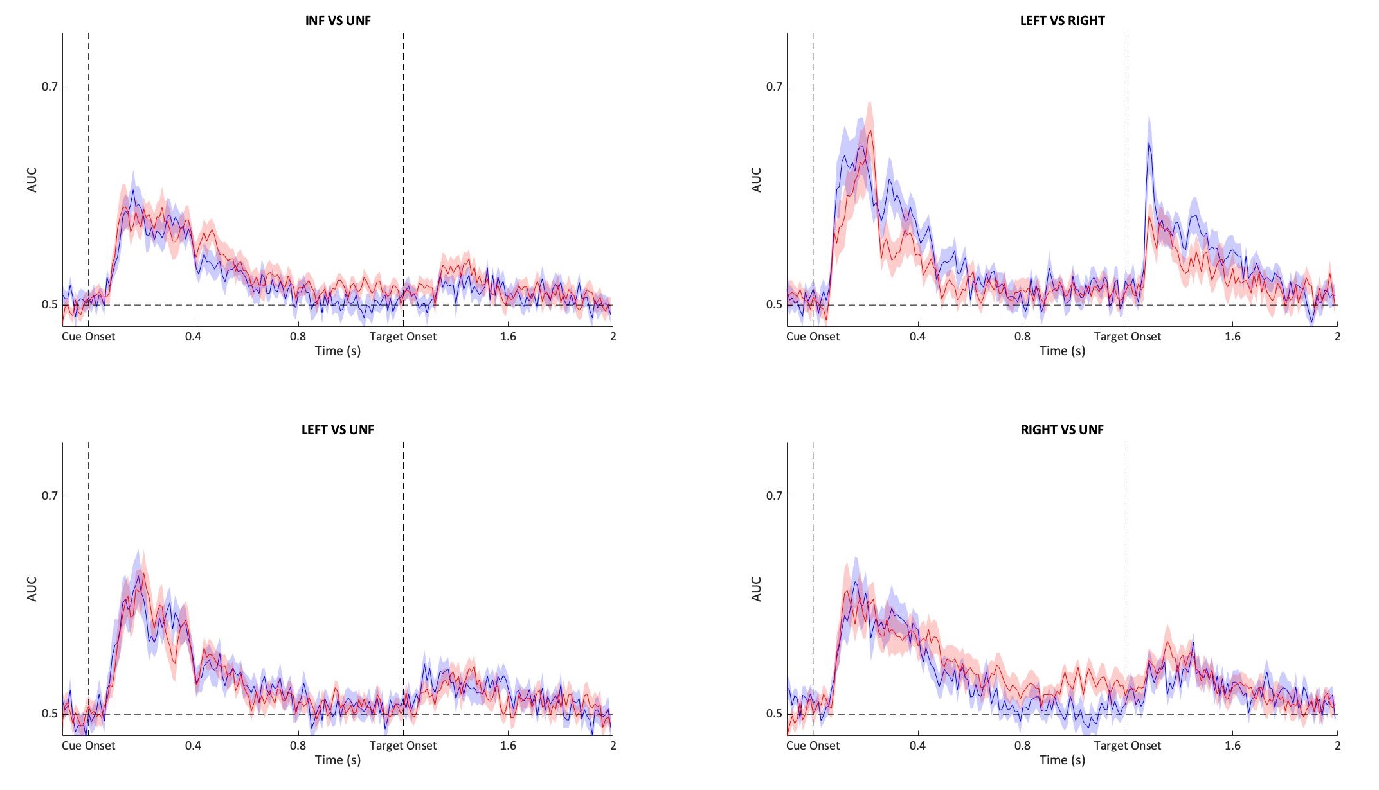
sensor
EEG
MEG

Slide 6
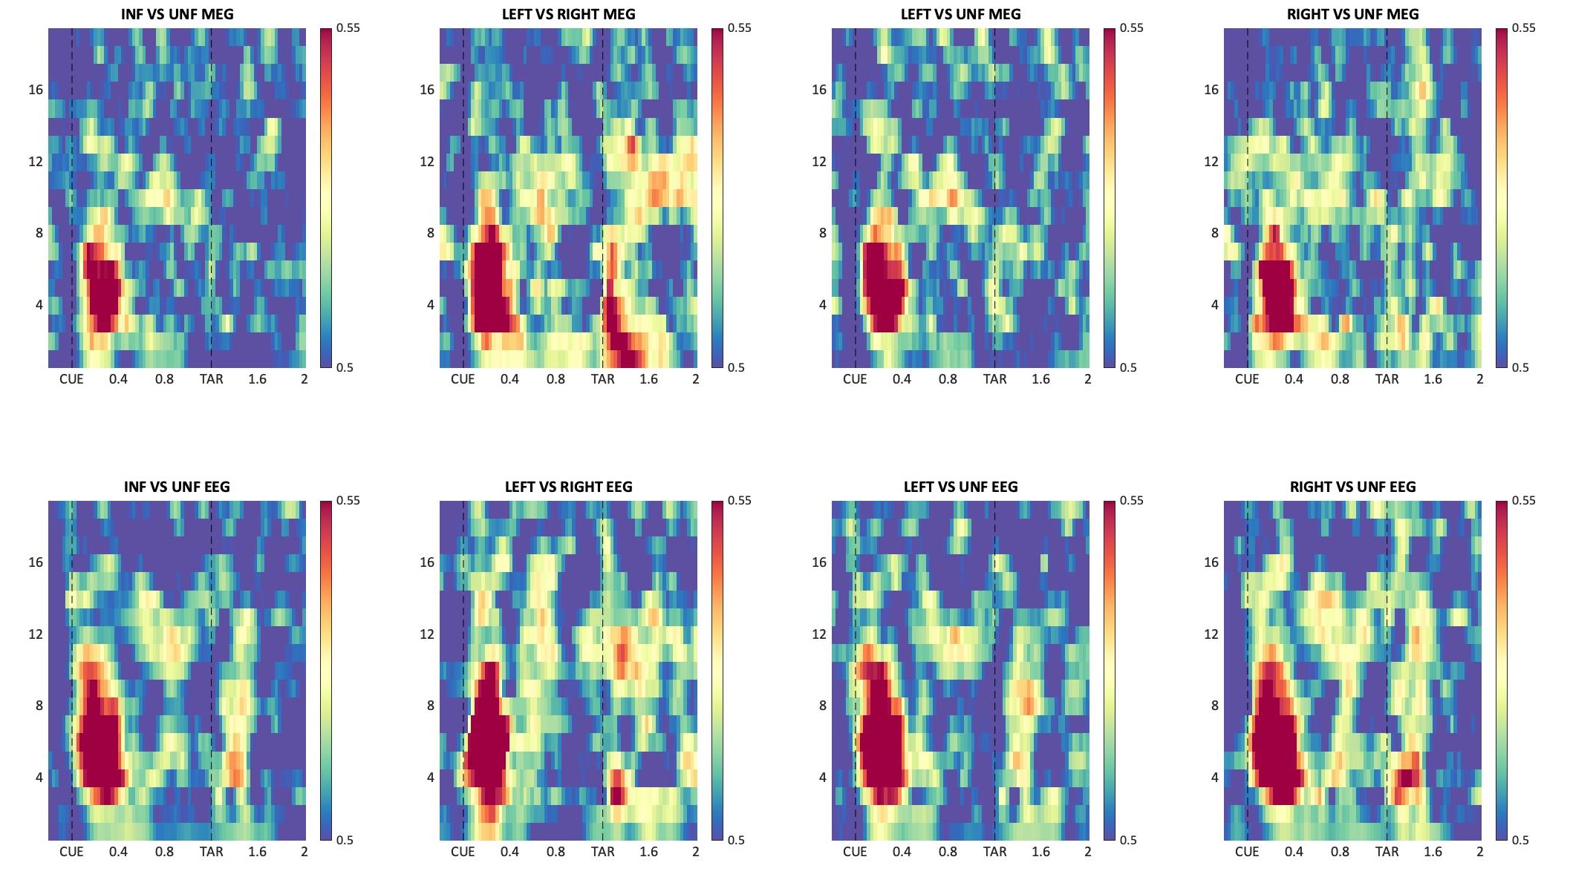
Time
Freq

Slide 7
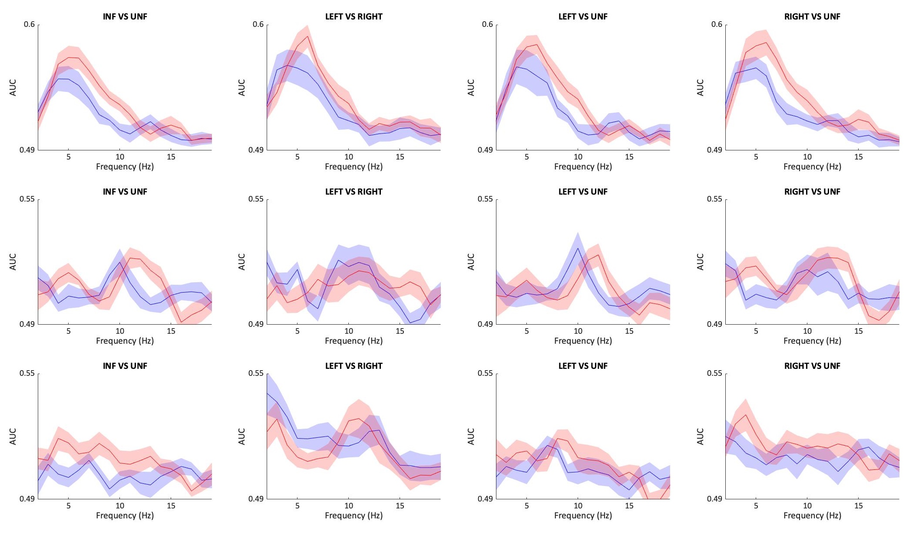
Time
Freq
Post
cue
Pre Tar
Post Tar
EEG
MEG

Slide 8
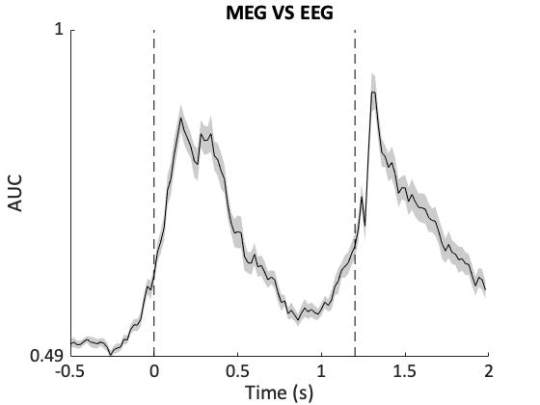
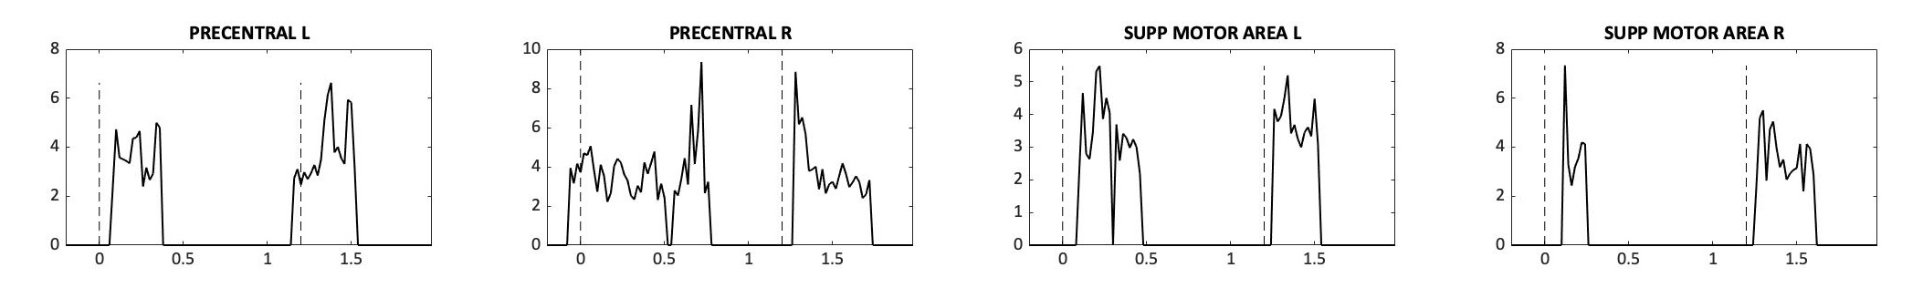
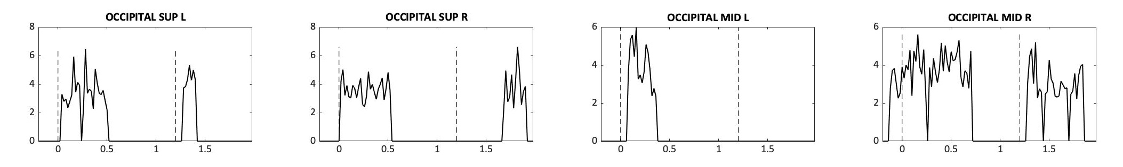
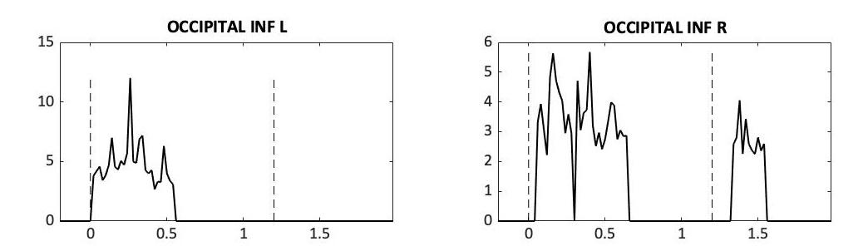
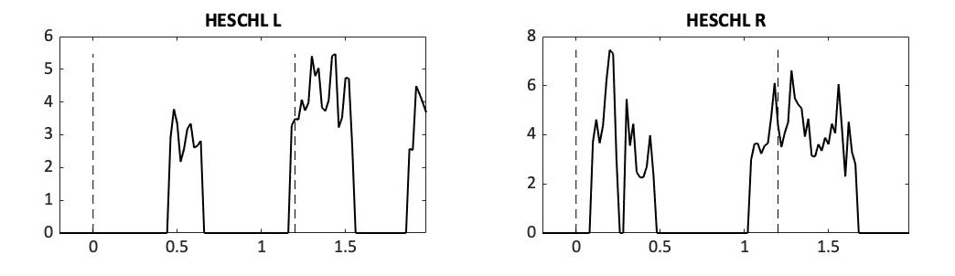
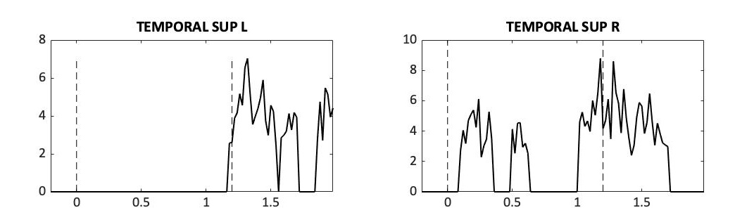
source
motor
visual
auditory

Slide 9
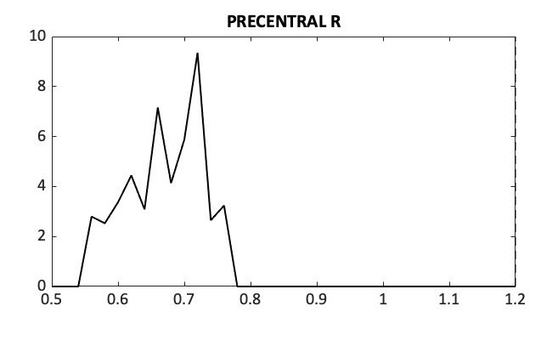
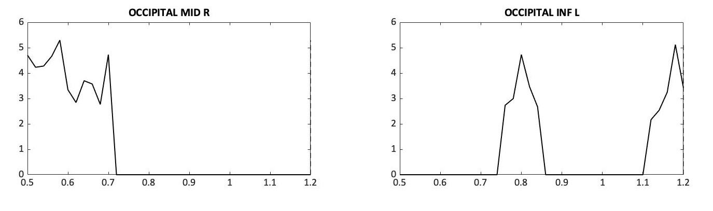
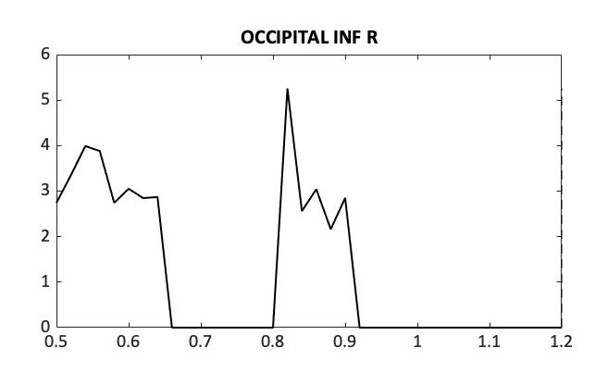
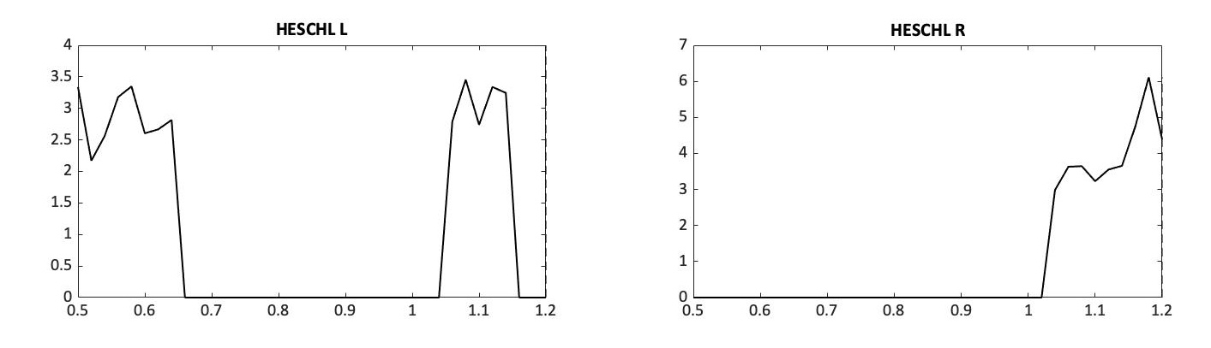
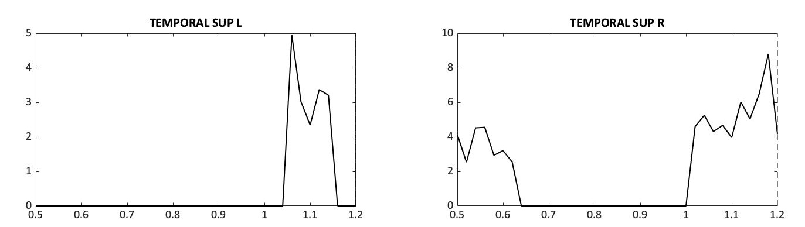
source
motor
visual
auditory

Slide 10
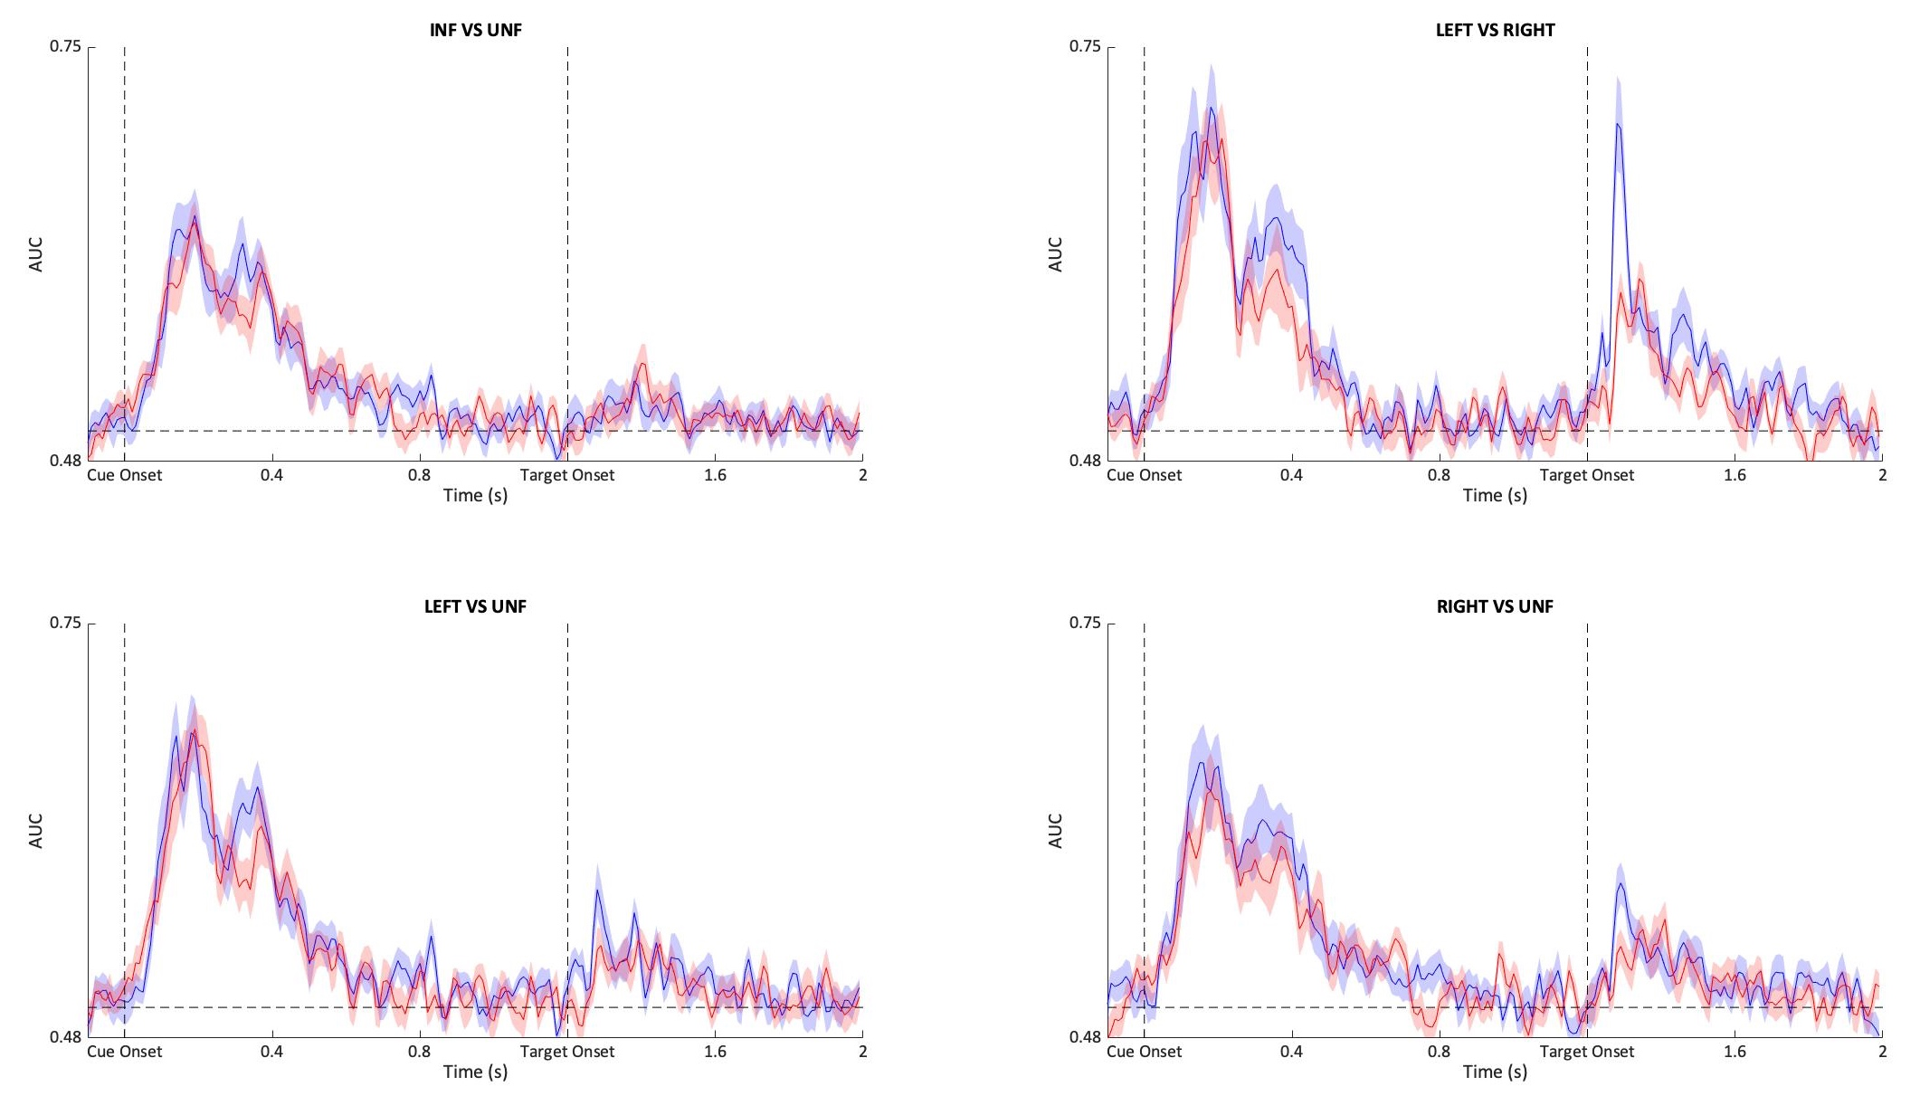
source

Slide 11
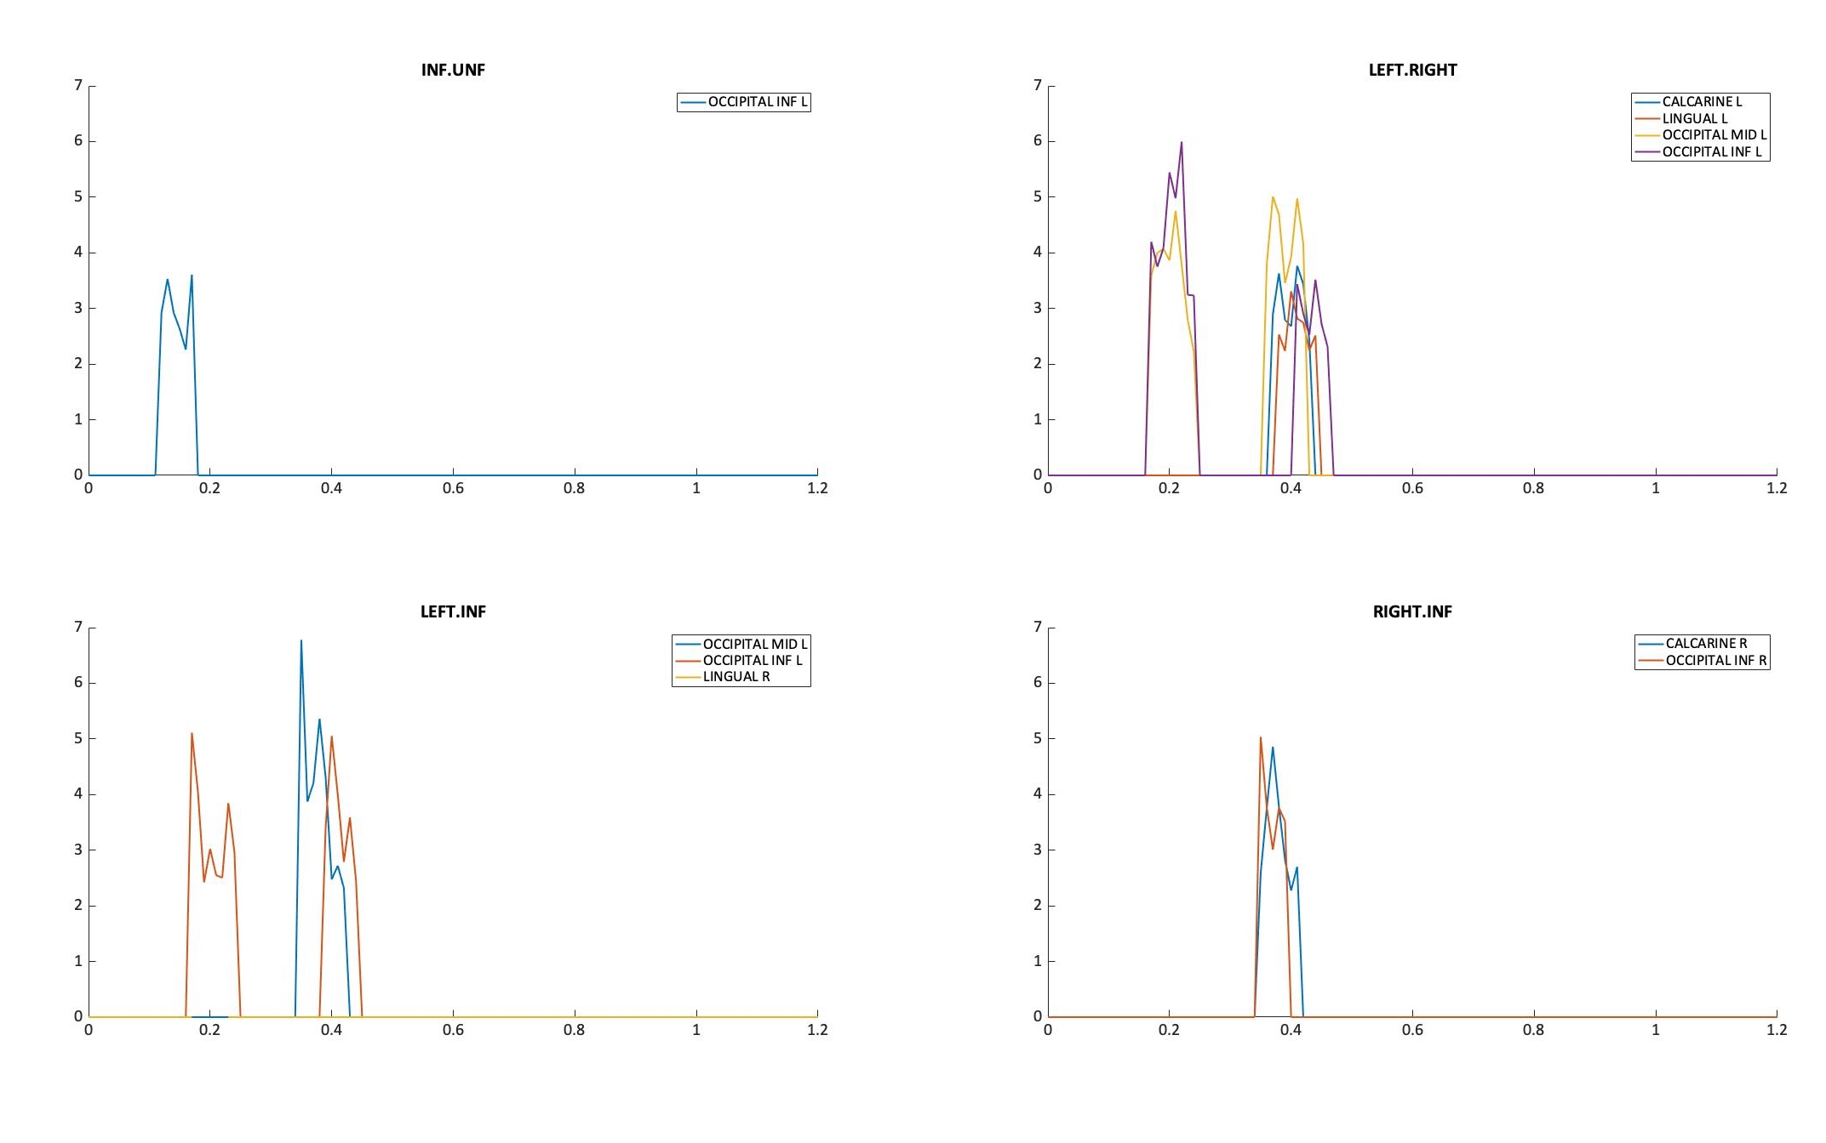
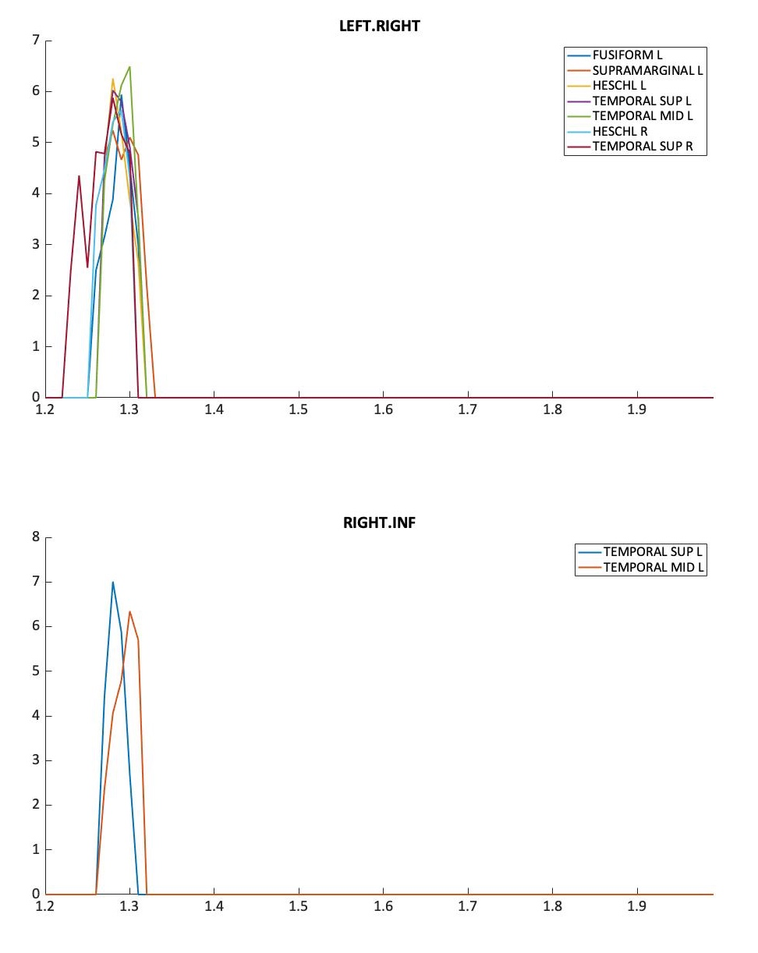
source

Slide 12
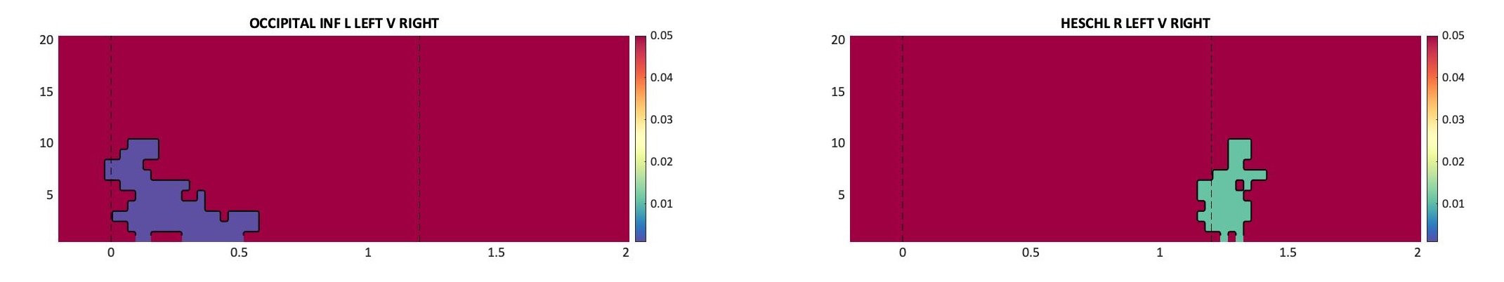
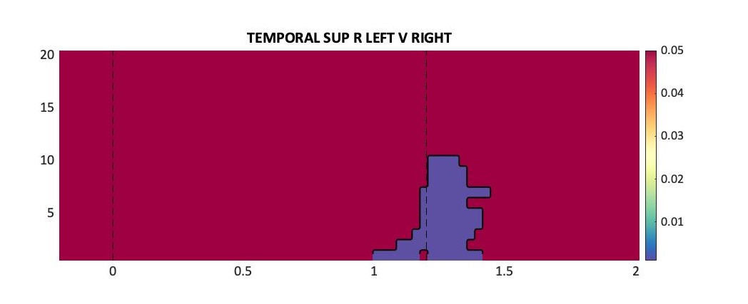
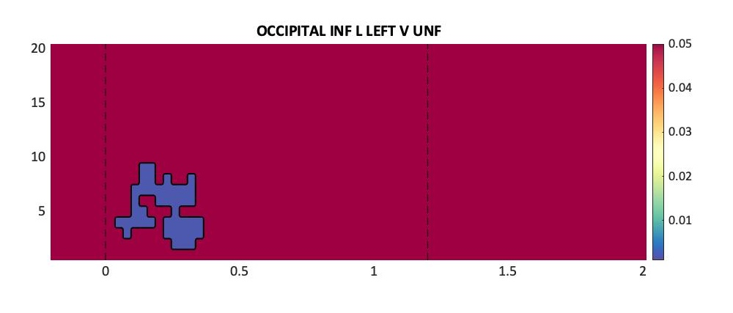
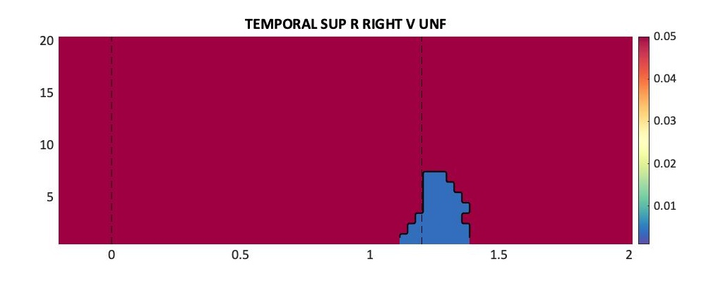
source

Slide 13

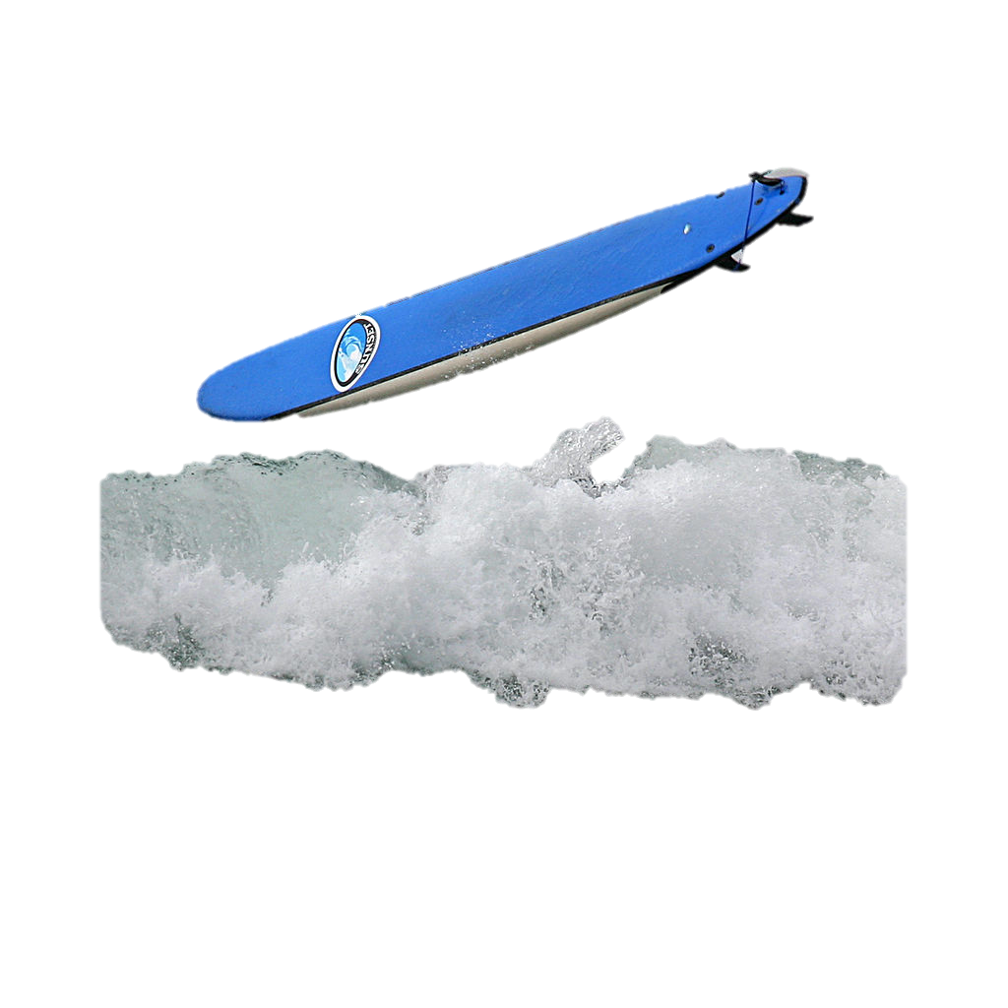

Figure.
Me thinking of a conclusion

